Slide 1

Computer Networking
Presentation
Project
Visit To NADRA
(National Database & Registration Authority)
Group Members
Muhammad Bilal
19-ARID-825
Muhammad Shoaib
19-ARID-839

Slide 2
Introduction
Visited Mianwali NADRA Office.
Headquarter in Islamabad
Main Branch In Sargodha
Location Id : 1060

Slide 3

network overview
They are using Private Network
Taking Internet from PTCL
Using Linux Server having IP 10.14.60.89
Using Oracle Database
Having minimum 5 PCs in each Office
No WIFI
Limited Access

Slide 4

Topology
NADRA is using Star Topology in which each office contain a switch through which all the devices and PCs connected

Slide 5
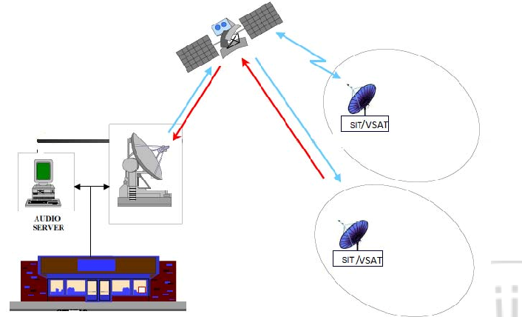
emergency backup
Digital Video Broadcasting - Return Channel via Satellite (DVBRCS)
Now they are getting backup from Zong and Jazz

Slide 6
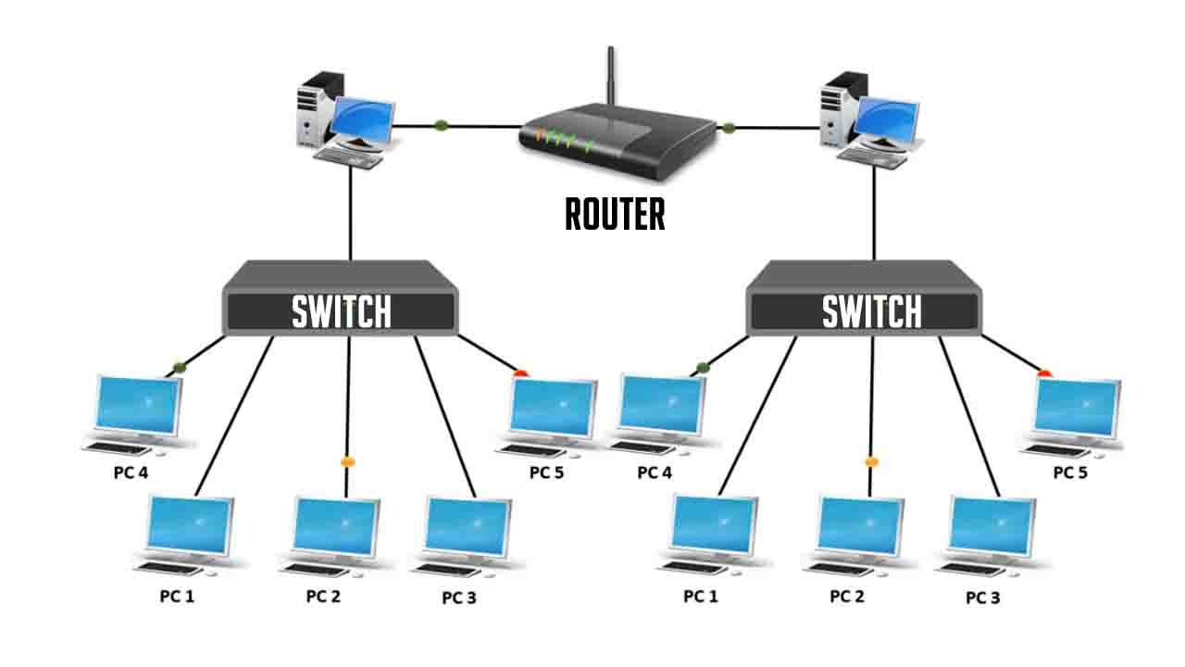
division
They are Taking internet from PTCL ISP
They have 5 offices
In each office there is 5 PCs
Dividing Internet by Routers and switches

Slide 7

limited access
There is Limited access of internet.
Only Few websites are accessible.
There is login Id of each employee.

Slide 8
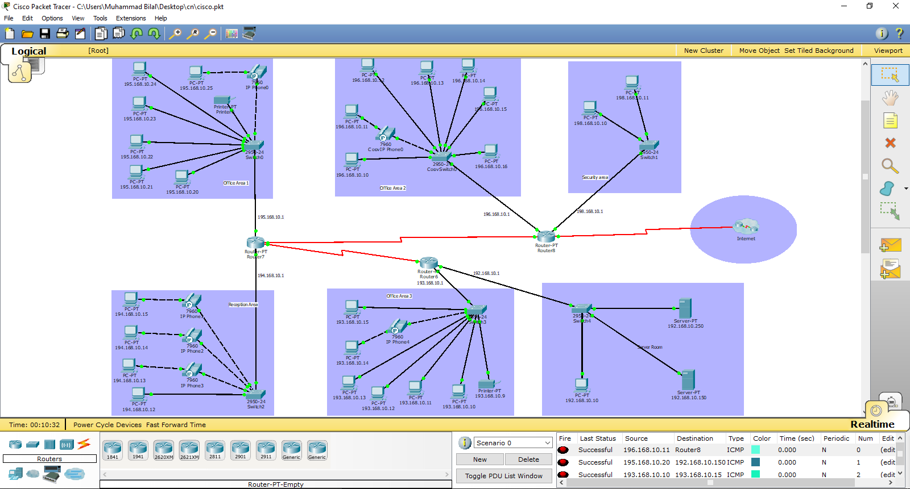
cisco packet tracer View

